Slide 1

Automation for Indian Agricultural to analyze fitness and life-cycle of crops using drones Dept. of Computer Science and Engineering
Team Members:
Santosh Kr Mahato-1417139
Eshan Dutta-1417111
Dinesh M-1417161
Project Guide:
Prof. Mahesh D.S

Slide 2
Agenda
Problem Statement.
Literature Survey.
Analysis and Study.
Hardware & Software requirements
Methodology Proposed.
Actual Work.
Algorithms Implementation.
Future Scope.
Conclusion.
References.

Slide 3
Problem Statement
This project has been inspired from the epitome of current hitches in Indian agriculture.
Our nation imbibes mechanization and technology in very few parts of the country, whereas the majority still continues to thrives on conventional methods.
There is a steady decline in the agricultural production due to plant infestation and diseases.
Farmers experience great difficulties in controlling diseases that spreads abnormally, this leads to intensive use of pesticides causing incorrect diagnosis.
Early detection is a major challenge in agricultural science. Development of proper methodology is certainly of use in this area.

Slide 4
Problem Statement & Objectives
1. Analyze and improve the life cycle of the crops. 2. Detect pests/diseases in crops using image processing techniques. 3. Spray pesticides using drones.

Slide 5
Abstract
Christ University
As per the current agricultural trends in India, crop protection and crop enhancement is the top priority due to decline in the production rate caused due to pests and other crop diseases.
The agricultural growth has faced potential threat due to increase in the demand and decline in production. In order to prevent plant diseases, we have come up with image processing techniques to monitor the crop growth.
Our project uses drones for surveillance of crops and identify diseases.
Photographs captured from drone in agricultural fields will be processed in a computer device to analyze and decide whether the crops are healthy or not.
Keywords- agriculture; crop disease; image processing; drone.
Excellence and Service

Slide 6
Literature Survey
Literature survey and studies in agricultural science indicate lot of studies done to improve the crop growth and its life cycles.
Development of an automated system for identifying and classifying different diseases of the contaminated plants is an emerging research area in precision agriculture.
Identiﬁcation of the diseases is the key to prevent qualitative and quantitative loss of agricultural yields.
The present study is concerned with detection of diseases that affects crops and causes decline in production.

Slide 7
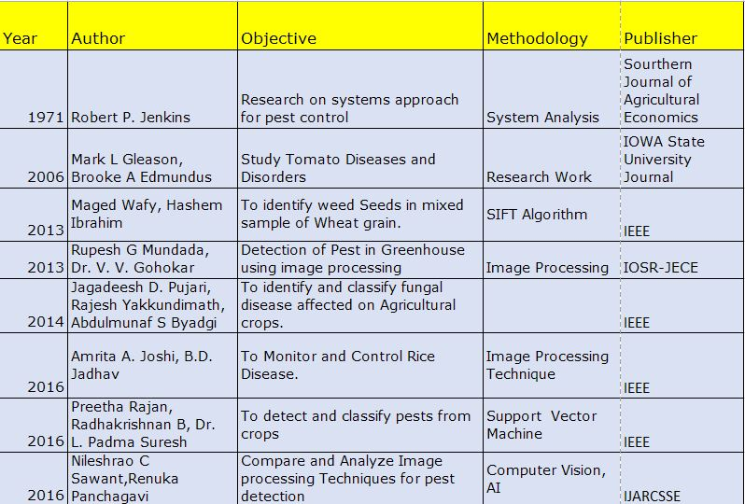
Literature Survey.
Christ University
Excellence and Service

Slide 8
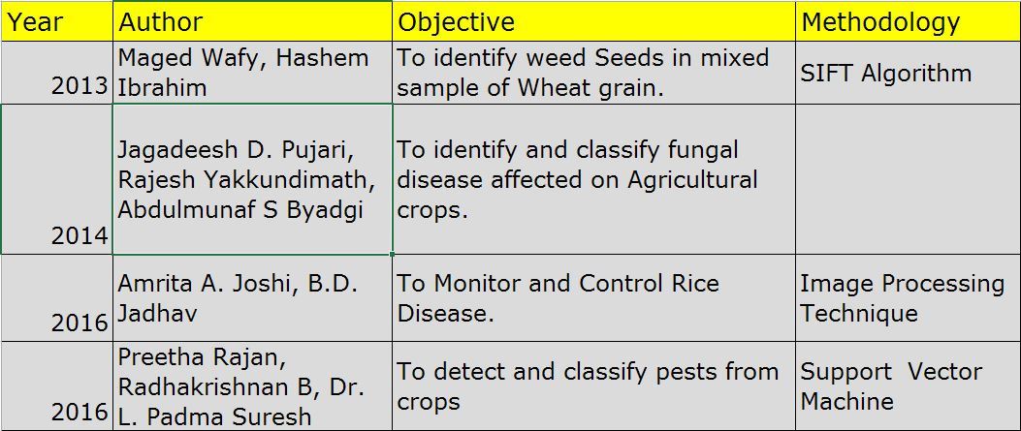
Literature Survey.
Christ University
Excellence and Service

Slide 9
Analysis and Study
As per the 2010 FAO (Food and Agricultural Organization) agriculture statistics, India is the world's largest producer of many fresh fruits and vegetables, milk, major spices, fibrous crops such as jute.
Today India ranks second worldwide in farm output. India has over 210 million acres of farmland.
India is the second largest producer of wheat and rice, the world's major food staples such as millets and castor oil seed..
India is the world's second or third largest producer of several dry fruits, agriculture-based textile raw materials, roots and tuber crops, pulses, farmed fish, eggs, coconut, sugarcane and numerous vegetables.
India ranked in the world's five largest producers of over 80% of agricultural produce items, including many cash crops such as coffee and cotton, in 2010.

Slide 10
Methodology Proposed.
Early detection and diagnosis is the main objective of the methodology proposed.
Computer image processing technologies have been used widely in the studies of plant diseases.
The descriptions can be extracted from a training image, then it will be used to match between the object in a trained image and test image containing many other features.

Slide 11
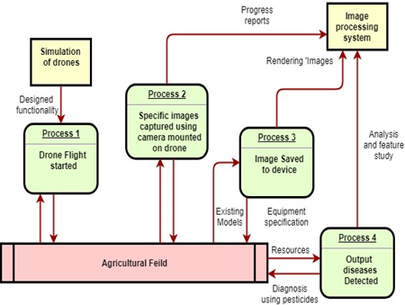
Methodology Proposed.

Slide 12
Hardware & Software Requirements
Software requirements:
Python with openCV
Windows/Linux OS
IvideoOn and IPWebcam (Android app)
Hardware Requirements:
Drones components
Rotor motor(1000rpm 4 nos)
Propellers
Flight microcontroller
ESCs-electronic speed control
Battery(2200 mah)
RC transmitter
PDB-power distribution
Frame
Camera

Slide 13
Actual Work
Stages of project:
1. Image Acquisition.
2. Image Processing with Python Programs through OpenCV Algorithms.
3. Post-Implementation.

Slide 14
OpenCV algorithms
Algorithms/python programs :
Comparative study of two diseases using Thresolding
Brute Force Matcher
Python program to find diseases and provide solutions
(Septoria, leaf mold using openCV property-Hough circles)

Slide 15
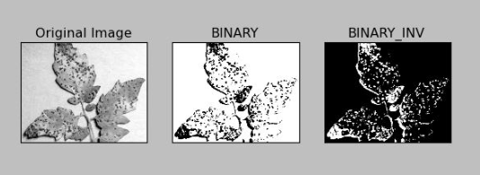
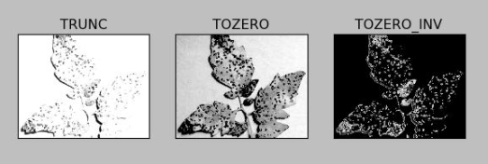
Comparative Study

Slide 16
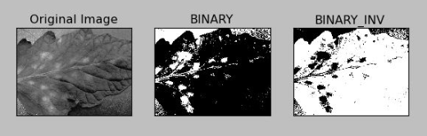
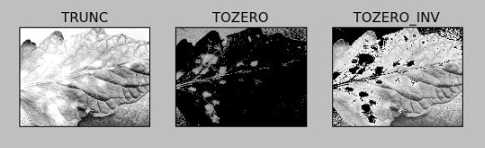
Comparative Study 2

Slide 17
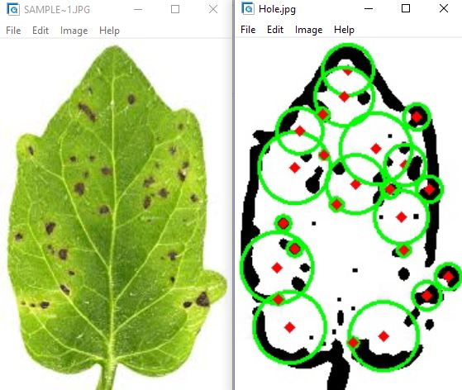
Sample Output(Hough Circles)

Slide 18
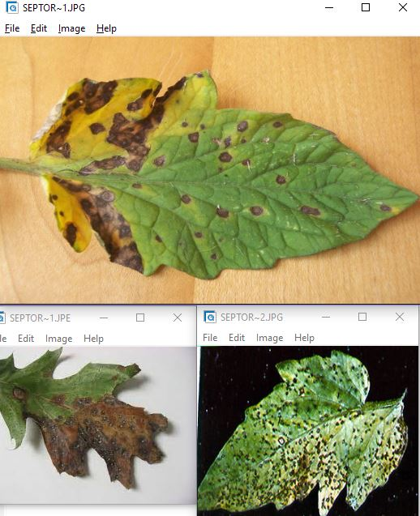
Sample output (unhealthy leaf)

Slide 19
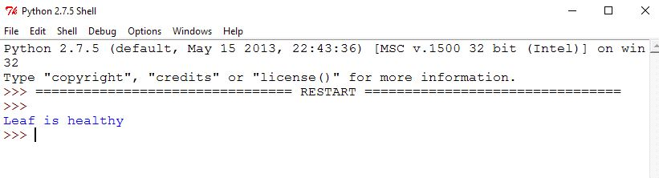
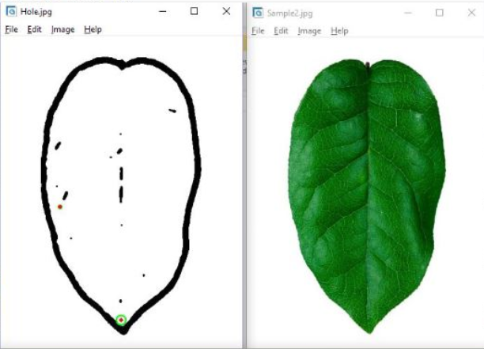
Sample Output (Healthy leaf)

Slide 20
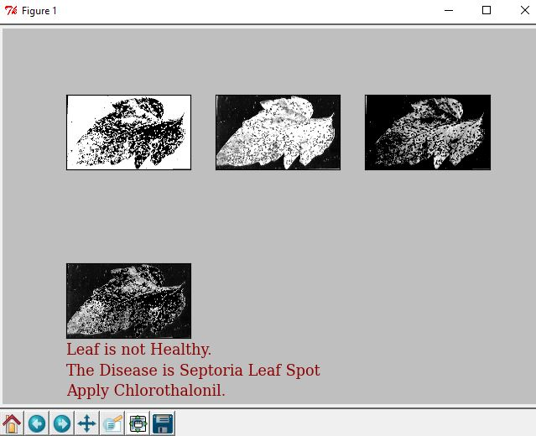
Output 1

Slide 21
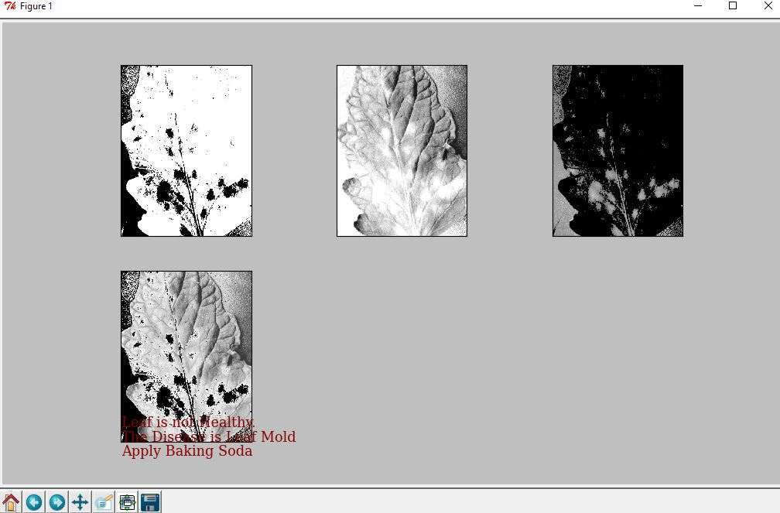
Output 2

Slide 22
Future Scope
Plant Disease management is a challenging task. In that mostly diseases are seen on the leaves of the plant.
The main characteristics of disease detection are speed and accuracy. Hence working on development of automatic, efficient, fast and accurate which is use for detection disease leaf.
Work can be extended for development of machine vision system that automatically recognizes, classify and quantitatively detects leaf disease symptoms.
The objective of this work is the detection, classification of diseases affecting on the plants, crops using image processing tools and all information about the disease is send to the farmer’s mobile phone through the GPRS.

Slide 23
Conclusion
Agriculture has come a long way in the past century. We produce more food than ever before, but our current model is unsustainable, and as the world’s population rapidly approaches the 8 billion mark, modern food production methods will need a radical transformation and we will need to keep up with the increasing demand. But luckily, there’s a range of new technologies that might make it possible.
The advantage of image processing technologies is to find out useful information contained in the images quickly and accurately.
The problem that it is difficult to accurately estimate plant disease severity can be solved using computer vision instead of naked-eye observation.

